Slide 1

MINOR PROJECT REVIEW -1 ML BASED WATER QUALITY PREDICTION FOR Aquaculture Guided by Presented by Dr. rajkumar.r G.srinivasulu(27016) M.praveenreddy(27150) Y.ganesh(27151)

Slide 2
ABSTRACT
This project proposes a machine learning approach for early detection of fish diseases by analyzing water quality. Utilizing a Gradient Boosting algorithm trained on water quality data, the aim is to predict fish health by assessing toxins and viruses in water samples. This proactive method allows for real-time monitoring and management of fish health, helping to prevent disease outbreaks and maintain healthy fish populations in aquaculture on Aquaculture plays a significant role in global food production, but fish diseases pose a major threat to the industry, leading to substantial economic losses and jeopardizing food security. This project proposes a machine learning-based approach for the early detection of fish diseases by analyzing water quality parameters.

Slide 3
OBJECTIVE
To predict the condition of the aquatic animals using water quality parameters by applying machine learning algorithms.
To test the water quality parameters; prepare the data set ; predict the values using ML algorithm.

Slide 4
Introduction
Maintenance of a healthy aquatic environment and production in ponds are two factors of primary importance for successful aquaculture culture operation.
The nutrient status of water play the most important role in governing the production.
The bottom soil governs the storage and release of nutrients to the overlying water through various chemical and biochemical processes for biological production in the environment.
Also, the physical condition and chemical composition of water quality are parameters to be taken care.
Water quality directly influence the survival and growth of fish, and hence, necessitate careful management.

Slide 5
LITERATURE SURVEY
S. NO | TITLE | PUBLISHED DETAILS | DESCRIPTION | INFERENCE
1. | Personalized Diet Recommendation System Using Machine Learning | Author: D. Navya Narayana Kumari, T. Praveen Satya Published in: IJERT, 2024 | Methodology: Used Nearest Neighbor model with cosine similarity. Materials: Streamlit for UI, FastAPI for backend. Limitations: Does not factor in disease levels like diabetes or real-time medical conditions. | The system successfully delivers personalized diet plans and nutritional recommendations to users, aiding in health management and weight control
2 | Machine Learning in Nutrition Research | Authors: Daniel Kirk,Esther Kok, Michele Tufano Published in:IJERT, 2024 | Methodology: Reviewed ML applications, applied ML on SPT data Materials: Streamlit Limitations: The performance of these models in distinct populations and with different data generation techniques is not guaranteed. | ML methods can significantly reduce the time and cost associated with traditional material tests by providing accurate predictions of material properties
3 | Diet Recommendation System Using Machine Learning | Authors: Yuvraj Chibber, Dushyant Betala, Srividhya S. Published in: International Conference on Recent Trends in Data Science and its Applications, 2022 | Methodology: Machine Learning algorithms, K-Means Algorithm. Materials: 90 food items, calories, fat, sugar, calcium, potassium. Limitations: Limited to 90 items, specific deficiencies, only on dietary recommendations. | The system effectively provides personalized diet plans based on user data, helping manage nutritional deficiencies and maintain a balanced diet.

Slide 6
S. NO | TITLE | PUBLISHED DETAILS | DESCRIPTION | INFERENCE
4 | A Novel Approach for Fish Disease Detection Using Water Quality Data and Machine Learning | Author: Ilias papastratis, Dimitrios kostanidis. Published in: Scientific Report, 2024. | Feature selection based on mutual information and random forest classifier | The paper only considers four water quality parameters and four fish diseases. The paper also does not validate the approach on different datasets or real-world scenarios.
5 | Diseased Fish Detection in the Underwater Environment Using an Improved YOLOV5 Network for Intensive Aquaculture | Authors: Sara Sweidan , S.S. Askar Published in:Fishes.Direct, 2024 | Improved YOLOV5 network with convolutional kernel group and convolutional block attention module | The paper only tests the model on a small dataset of 500 images of diseased fish. The paper also does not evaluate the model on different types of fish diseases or different water conditions.
6 | Water Quality Prediction and Disease Diagnosis in Aquaculture Using Deep Neural Networks | Authors:S. Sivakumar, R. Rajesh, and S. Sathish Kumar Published in: Aquaculture | Feature selection based on mutual information and random forest classifier | The paper only considers four water quality parameters and four fish diseases. The paper also does not validate the approach on different datasets or real-world scenarios.

Slide 7
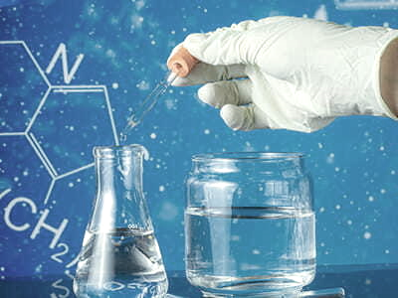
Water quality parameters
Dissolved Oxygen (DO) – Critical for fish respiration and aquatic health.
pH – Influences biological processes and the solubility of nutrients and gases.
Temperature – Affects metabolism, growth rates, and oxygen solubility.
Ammonia (NH₃) – Toxic to aquatic organisms at elevated levels.
Nitrite (NO₂) – Highly toxic to fish, especially in low-oxygen environments.

Slide 8
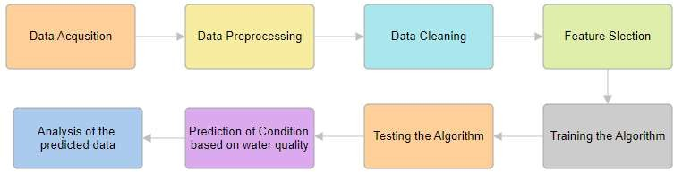
BLOCK DIAGRAM

Slide 9
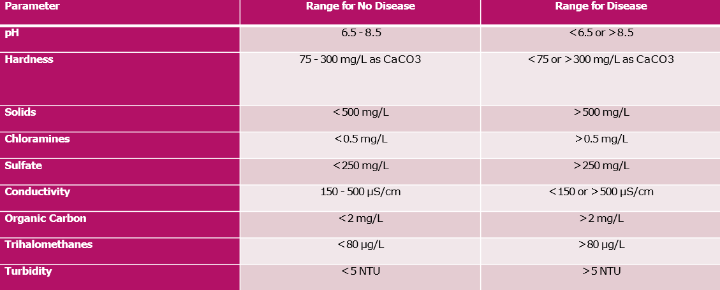
Range of Water quality Parameters

Slide 10
RESULTS
The Random Forest Classifier demonstrated the highest accuracy among the other algorithms utilized in the analysis.
Additionally, it identified "ph" as the most influential feature in predicting disease presence based on water quality metrics.
This underscores the significant role pH levels play in determining the likelihood of disease occurrence in aquatic environments.
Maintaining optimal pH levels is crucial for preventing the proliferation of harmful pathogens and ensuring the overall health of aquatic ecosystems.

Slide 11
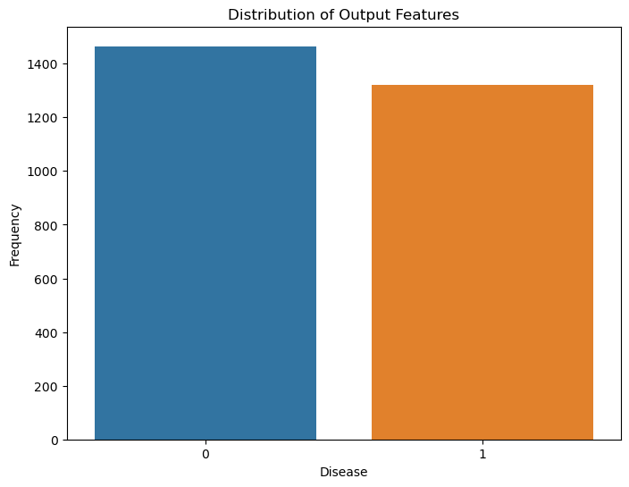
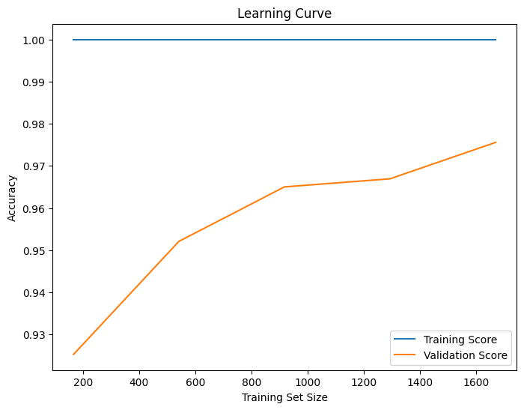
Distribution and Learning Curve

Slide 12
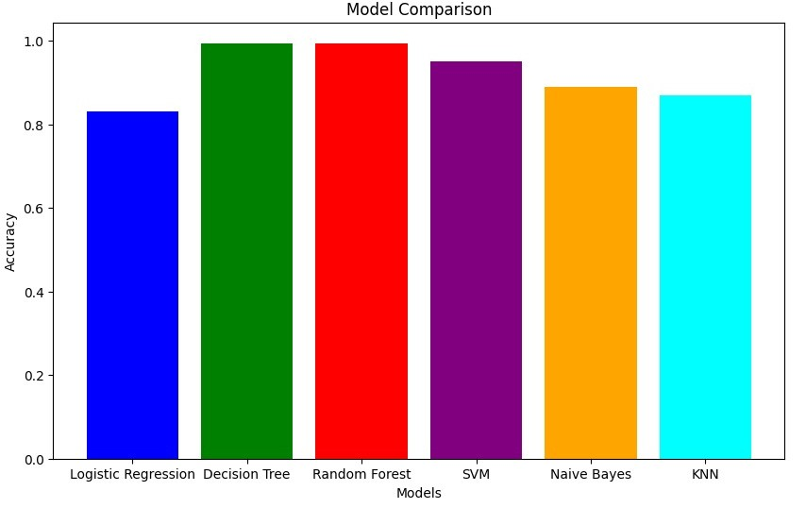
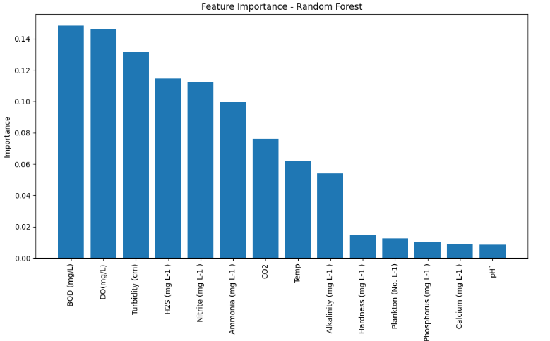
Cross validation and Feature Importance

Slide 13
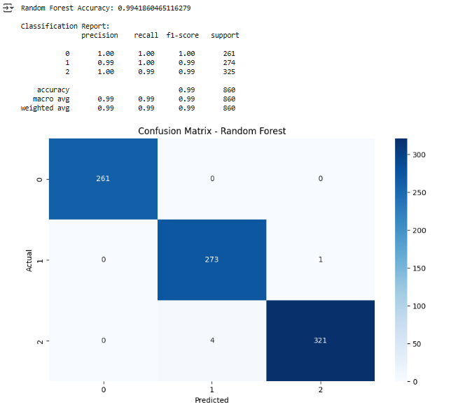
Random Forest
A Random Forest is an ensemble learning method that builds multiple decision trees using bootstrapped data samples and random feature selection.
Each tree's prediction is combined through voting (classification) or averaging (regression), resulting in improved accuracy, robustness, and generalization while reducing overfitting compared to single decision trees.

Slide 14
The Random Forest Classifier provided accurate meal recommendations with:
Breakfast Accuracy: High
Lunch Accuracy: High
Dinner Accuracy: High
Snack Accuracy: High
Visualization & Analysis
Feature Importance Analysis: Weight and activity level significantly impact dietary needs.
Actual vs. Predicted Plot: Shows strong alignment, confirming reliable predictions.
Discussion
The system successfully personalizes diet plans based on user inputs.
The classification model effectively identifies suitable meals.

Slide 15
WORK TO BE CARRIED OUT
Implement all machine learning algorithms
Classification among all ML algorithms.
Getting higher accuracy.

Slide 16
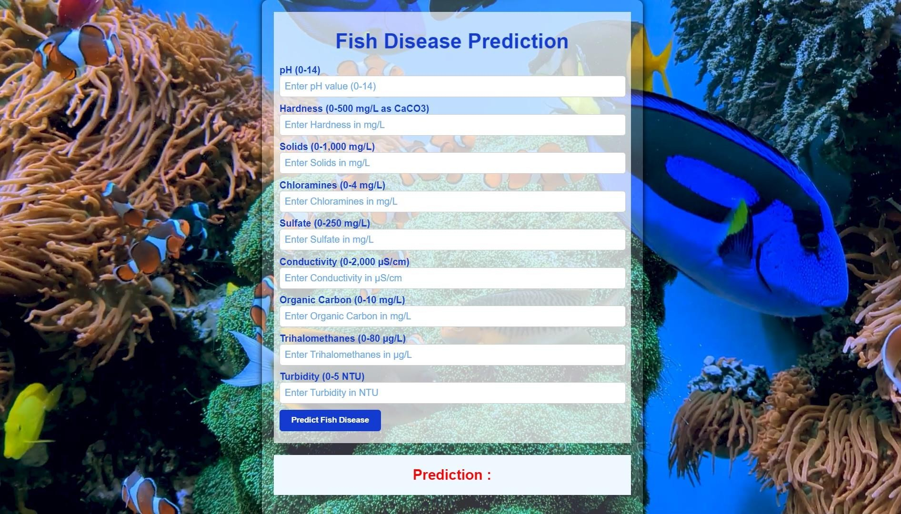
Web Application

Slide 17
Software Used
Python
HTML
CSS

Slide 18
Timeline Plan
Month | week | Task
Fed | 1 | Literature Survey
Feb | 2 | Framing the objective
Feb | 3 | Implementaion
Mar | 1 | Implementaion
Mar | 2 | Performance Evaluation
Mar | 3 | Comparison of Results
Mar | 4 | Documentation for Confence and repart Draft
Apr | 1 | Documentation for Confence and repart Draft
Apr | 2 | Final Report
Apr | 3 | Final Report
Apr | 4 | Final Report
12 weeks
Week wise should be planned

Slide 19
References
1.Q Huang, H Wang, S Hao, C Zhong, L Wang “Design and Fabrication of a High-Frequency Single-Directional Planar Underwater Ultrasound transducer,”. Mdpi Sensors, 2019.
2. A. Ashraf and A. Atia, "Comparative Study Between Transfer Learning Models to Detect Shrimp Diseases," 2021 16th International Conference on Computer Engineering and Systems (ICCES), Cairo, Egypt, Egypt, 2021, pp. 1-6, doi: 10.1109/ICCES54031.2021.9686116.
3. Fu-Sung Lin “A Machine-Learning-Based Ultrasonic System for Monitoring White Shrimps” IEEE sensors journal, Oct.1, 2023
4. Gadhiraju Tej Varma; Adusumilli Sri Krishna, et al.,”SDNet: Integrated Unsupervised Learning with DLCNN for Shrimp Disease Detection and Classification”, IEEE, International Conference, 2023.

Slide 20
6. P. Kirankumar; G. Keertana; S U Abhinash Sivarao; B. Vijaykumar; Sh. Chetan Shah, “ Smart Monitoring and Water Quality Management in Aquaculture using IOT and ML”, IEEE International Conference, 2024.
7. Taji Khaoula*, Rachida Ait Abdelouahid, Ibtissame Ezzahoui,Abdelaziz Marzak, “Taji Khaoula*, Rachida Ait Abdelouahid, Ibtissame Ezzahoui,Abdelaziz Marzak”, Elsvier, 2025.
8.CrouseC. et al*,The effects of two water temperature regimes on Atlantic salmon (Salmo salar) growth performance and maturation in freshwater recirculating aquaculture systemsAquaculture(2025)
9.FarajiM. et al.An integrated 3D CNN-GRU deep learning method for short-term prediction of PM2. 5 concentration in urban environmentSci. Total Environ.(2024)
10. WangS. et al.Prediction of estuarine water quality using interpretable machine learning approachJ. Hydrol.(2024)
11. TianC. et al.Developing a wind power forecasting system based on deep learning with attention mechanismEnergy(2024)

Slide 21
Thank you

